Slide 1
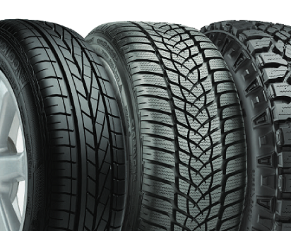
Tyre Quality Classification
NIE-MVI
-
Computational Intelligence Methods

Slide 2

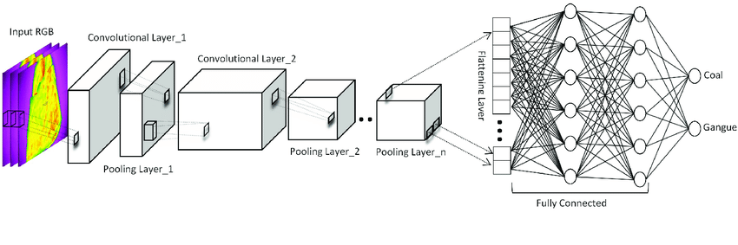
tf.keras.utils.image_dataset_from_directory
tf.keras.Sequential
tensorflow.keras.models
tensorflow.keras.optimizers

Slide 3
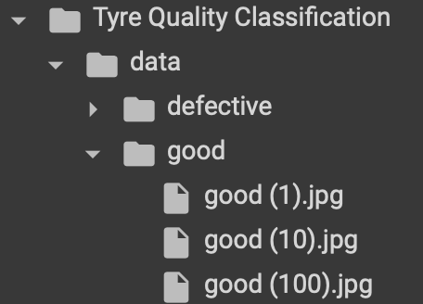
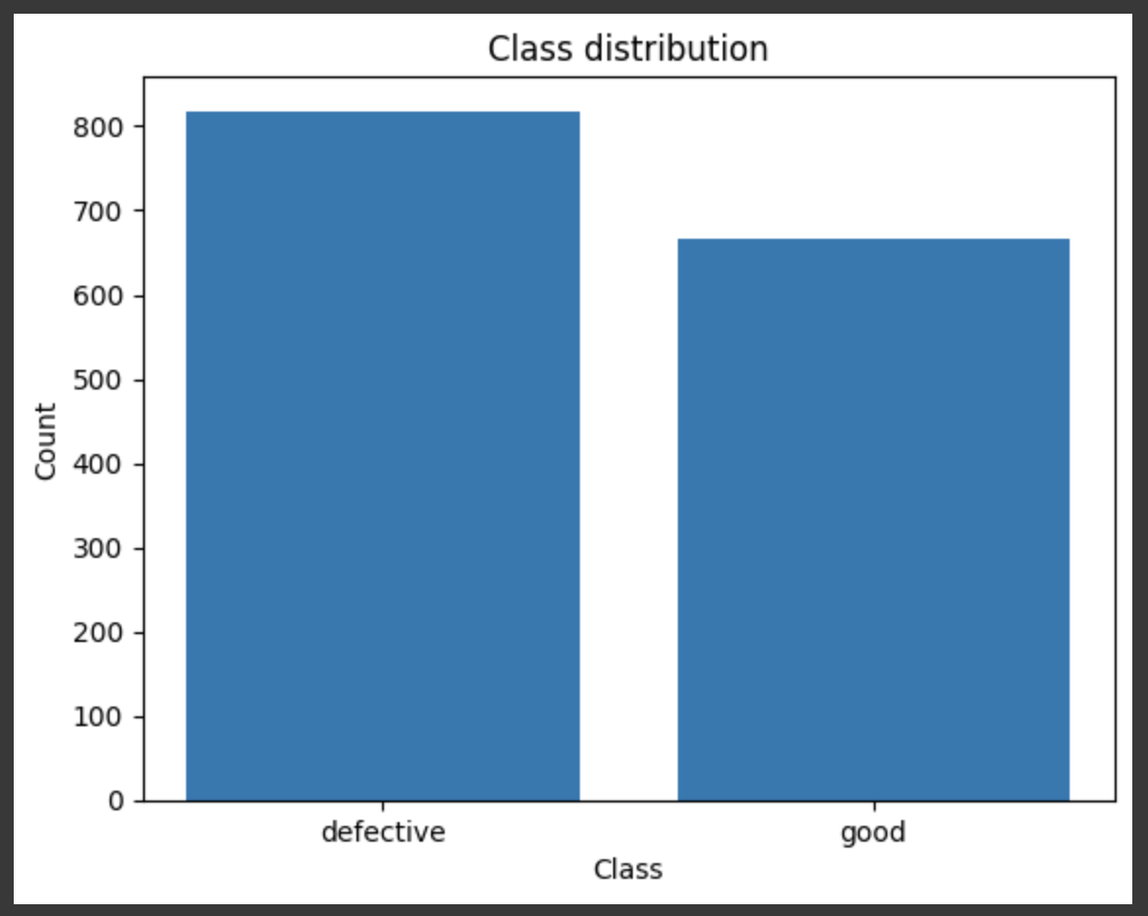
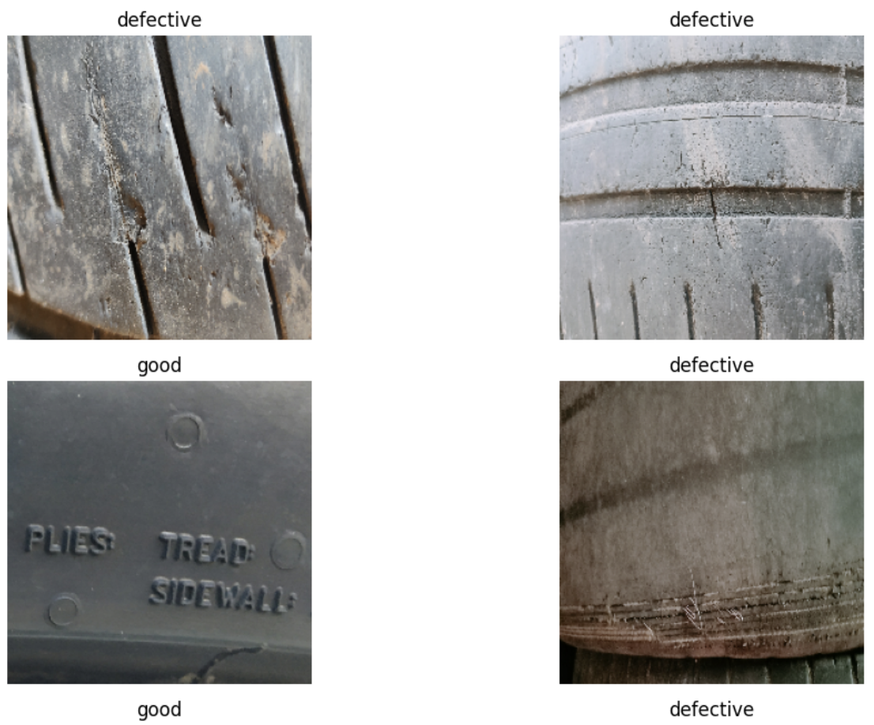
Data
- 1856 images in total
- No need of scaling according to me

Slide 4
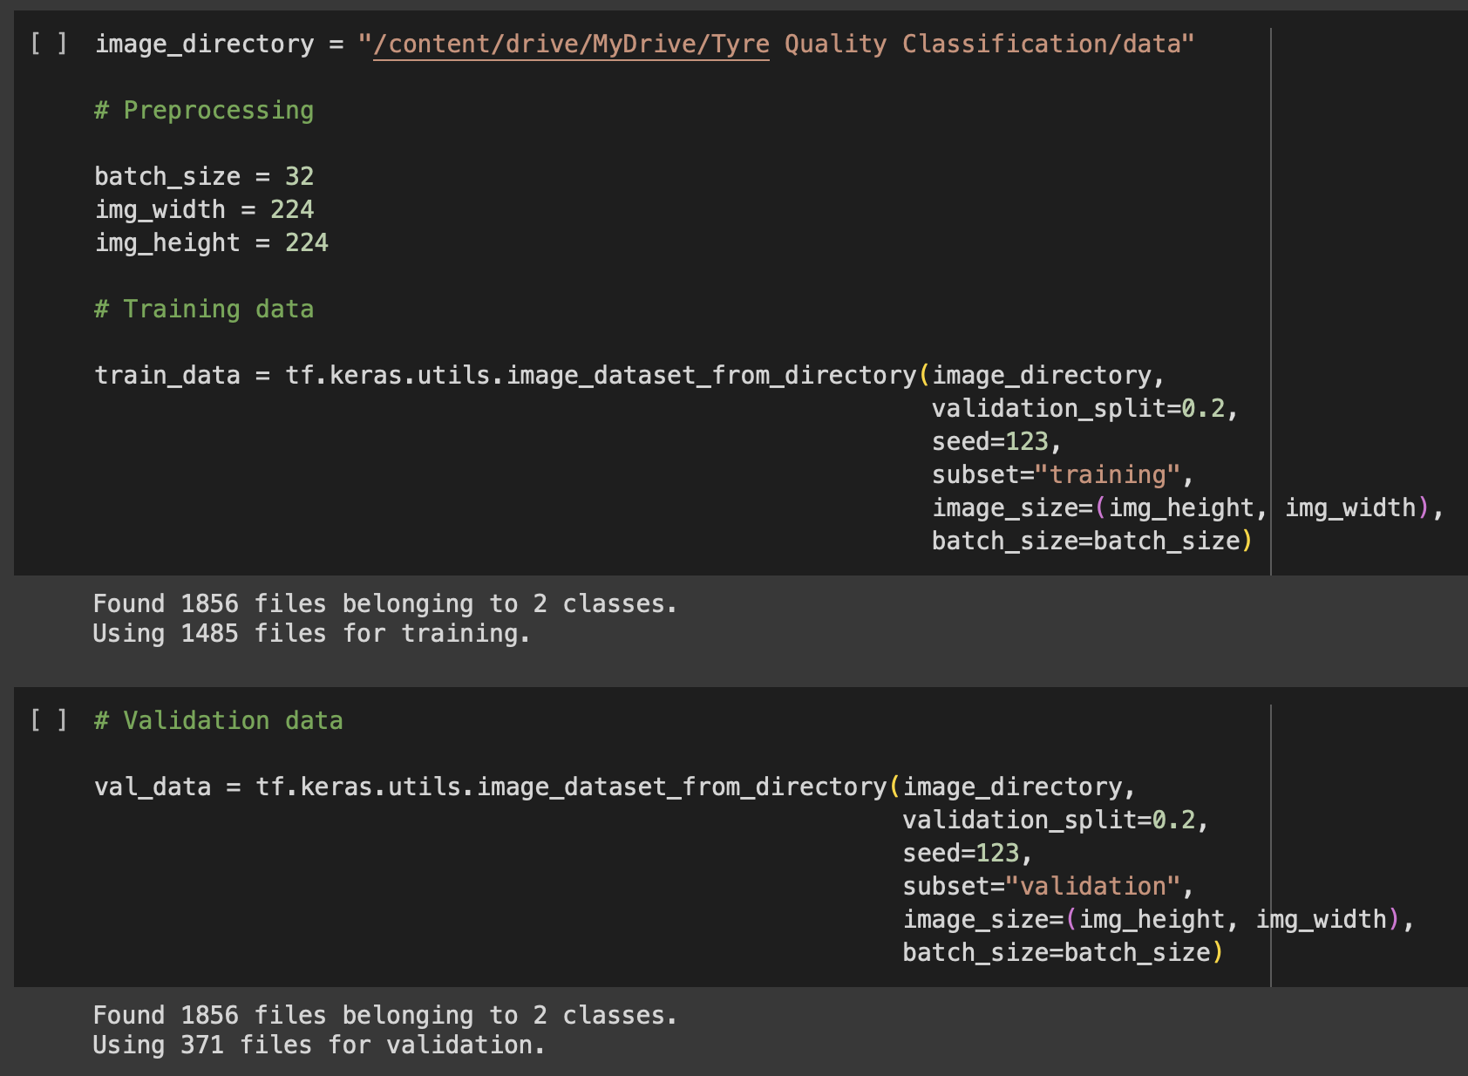
Preprocessing and splitting
- Fix batch size (number of samples that will be propagated through the network each iteration).
- Split training and validation set
- Set an input image so that your image is not too small to extract information and all the images have the same resolutions.

Slide 5
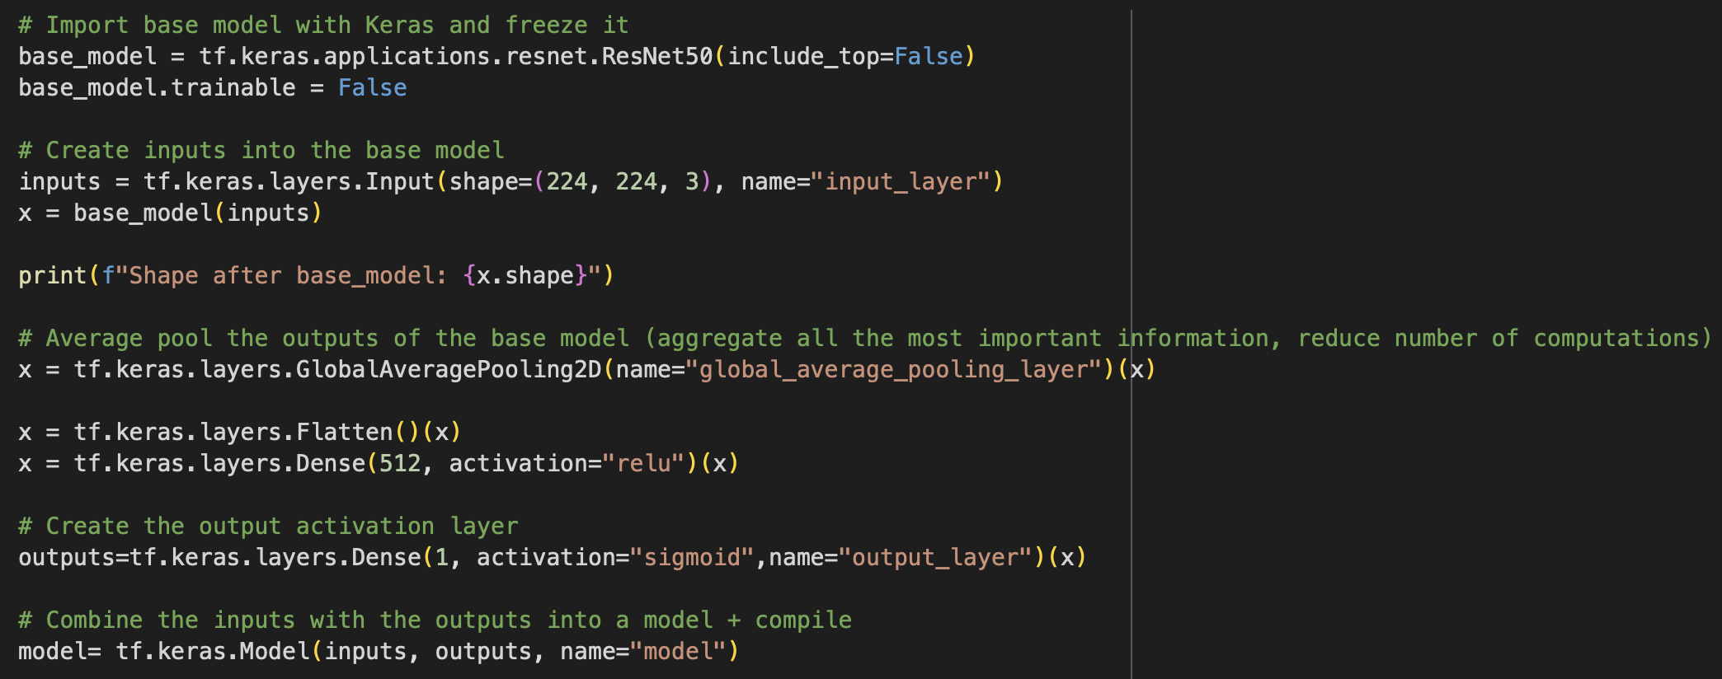
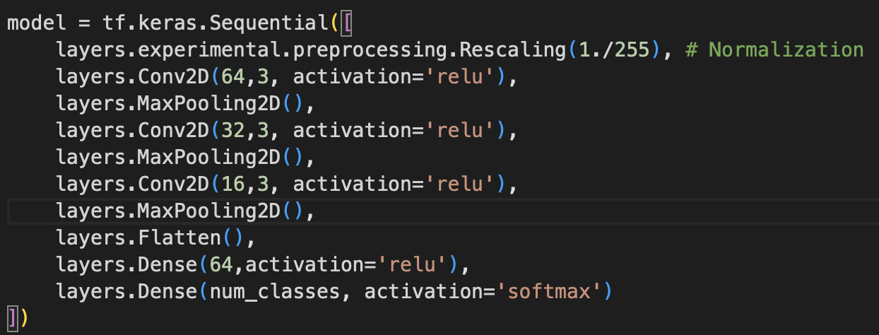
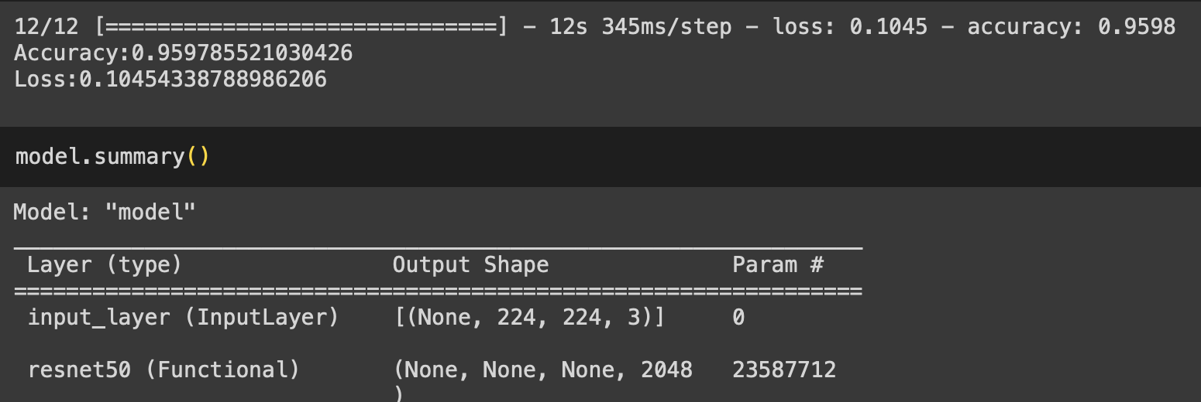
Models
1st CNN model, low accuracy (arround 65%-68%)
ResNet50 pre-trained + fine tuning
- 95%-98% accuracy ! - Much more parameters
- Increase the accuracy WITHOUT doing overfitting!
- Keep an eye on loss value and implementing callbacks.

Slide 6
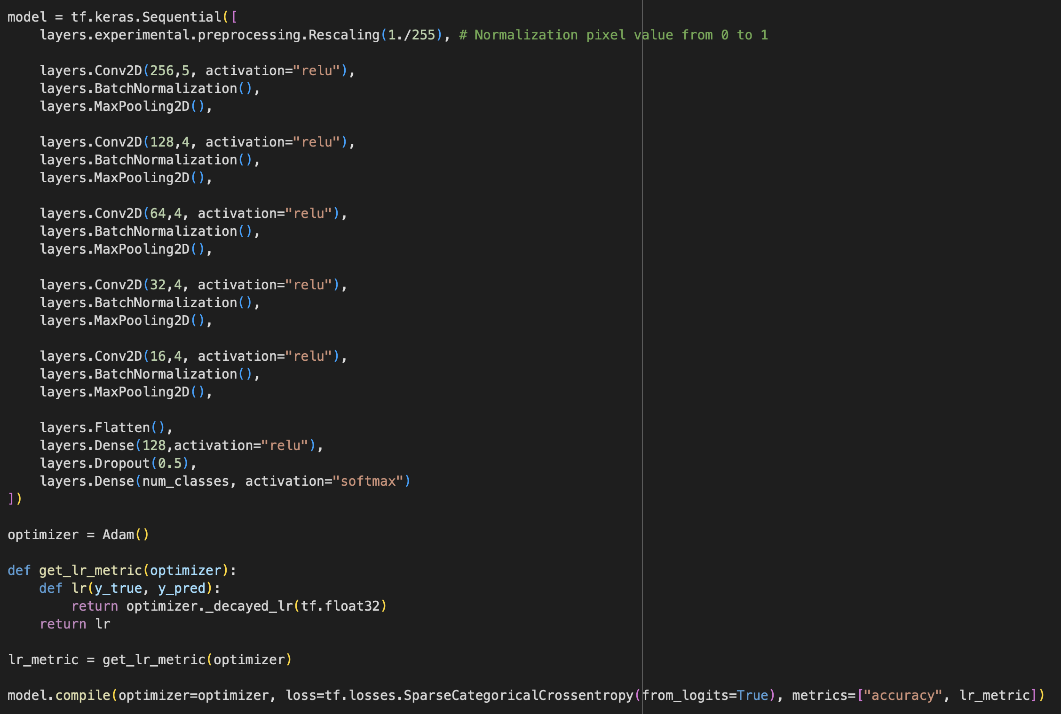
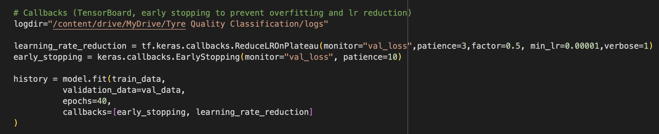
Enhanced CNN model
- Increase the number of epochs (30-50)
- Adding new Conv2D and Pooling2D layer.
- Adding a dropout layer for regularization (avoid overfitting by disabling some neurons)
- Adding early stopping callback improved to avoid overfitting
- Tried other optimizers (such as SGD & RMSprop) but Adam still the best.
- Adding adaptive learning rate callback, it adjusts the learning rate according to the loss value
- Changed kernel size 3 -> 4 -> improvements + tried to change input image -> worse
- Adding Batch Normalization to normalize the layers" inputs

Slide 7
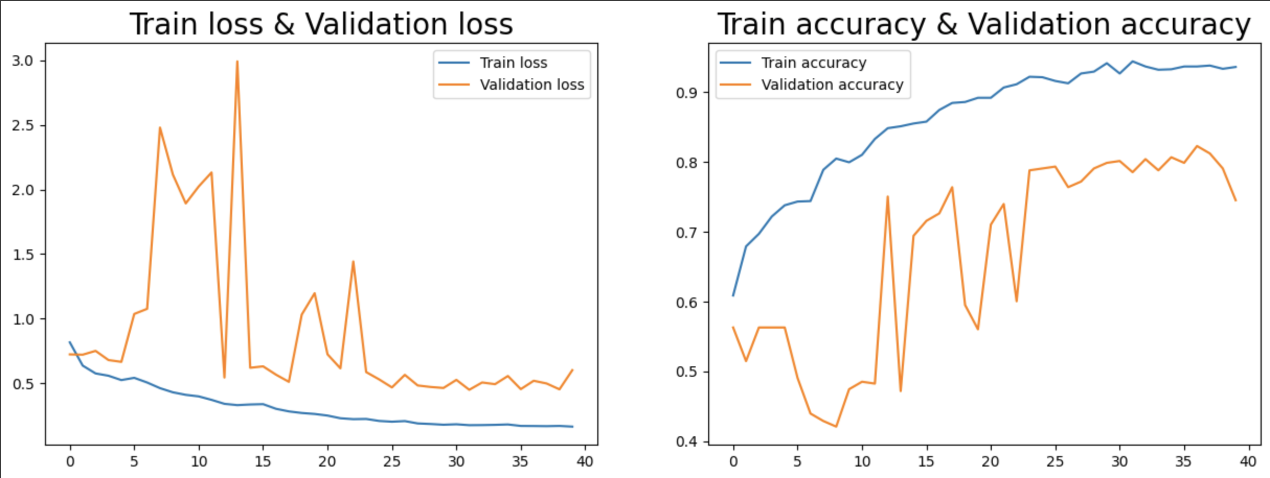

Slide 8
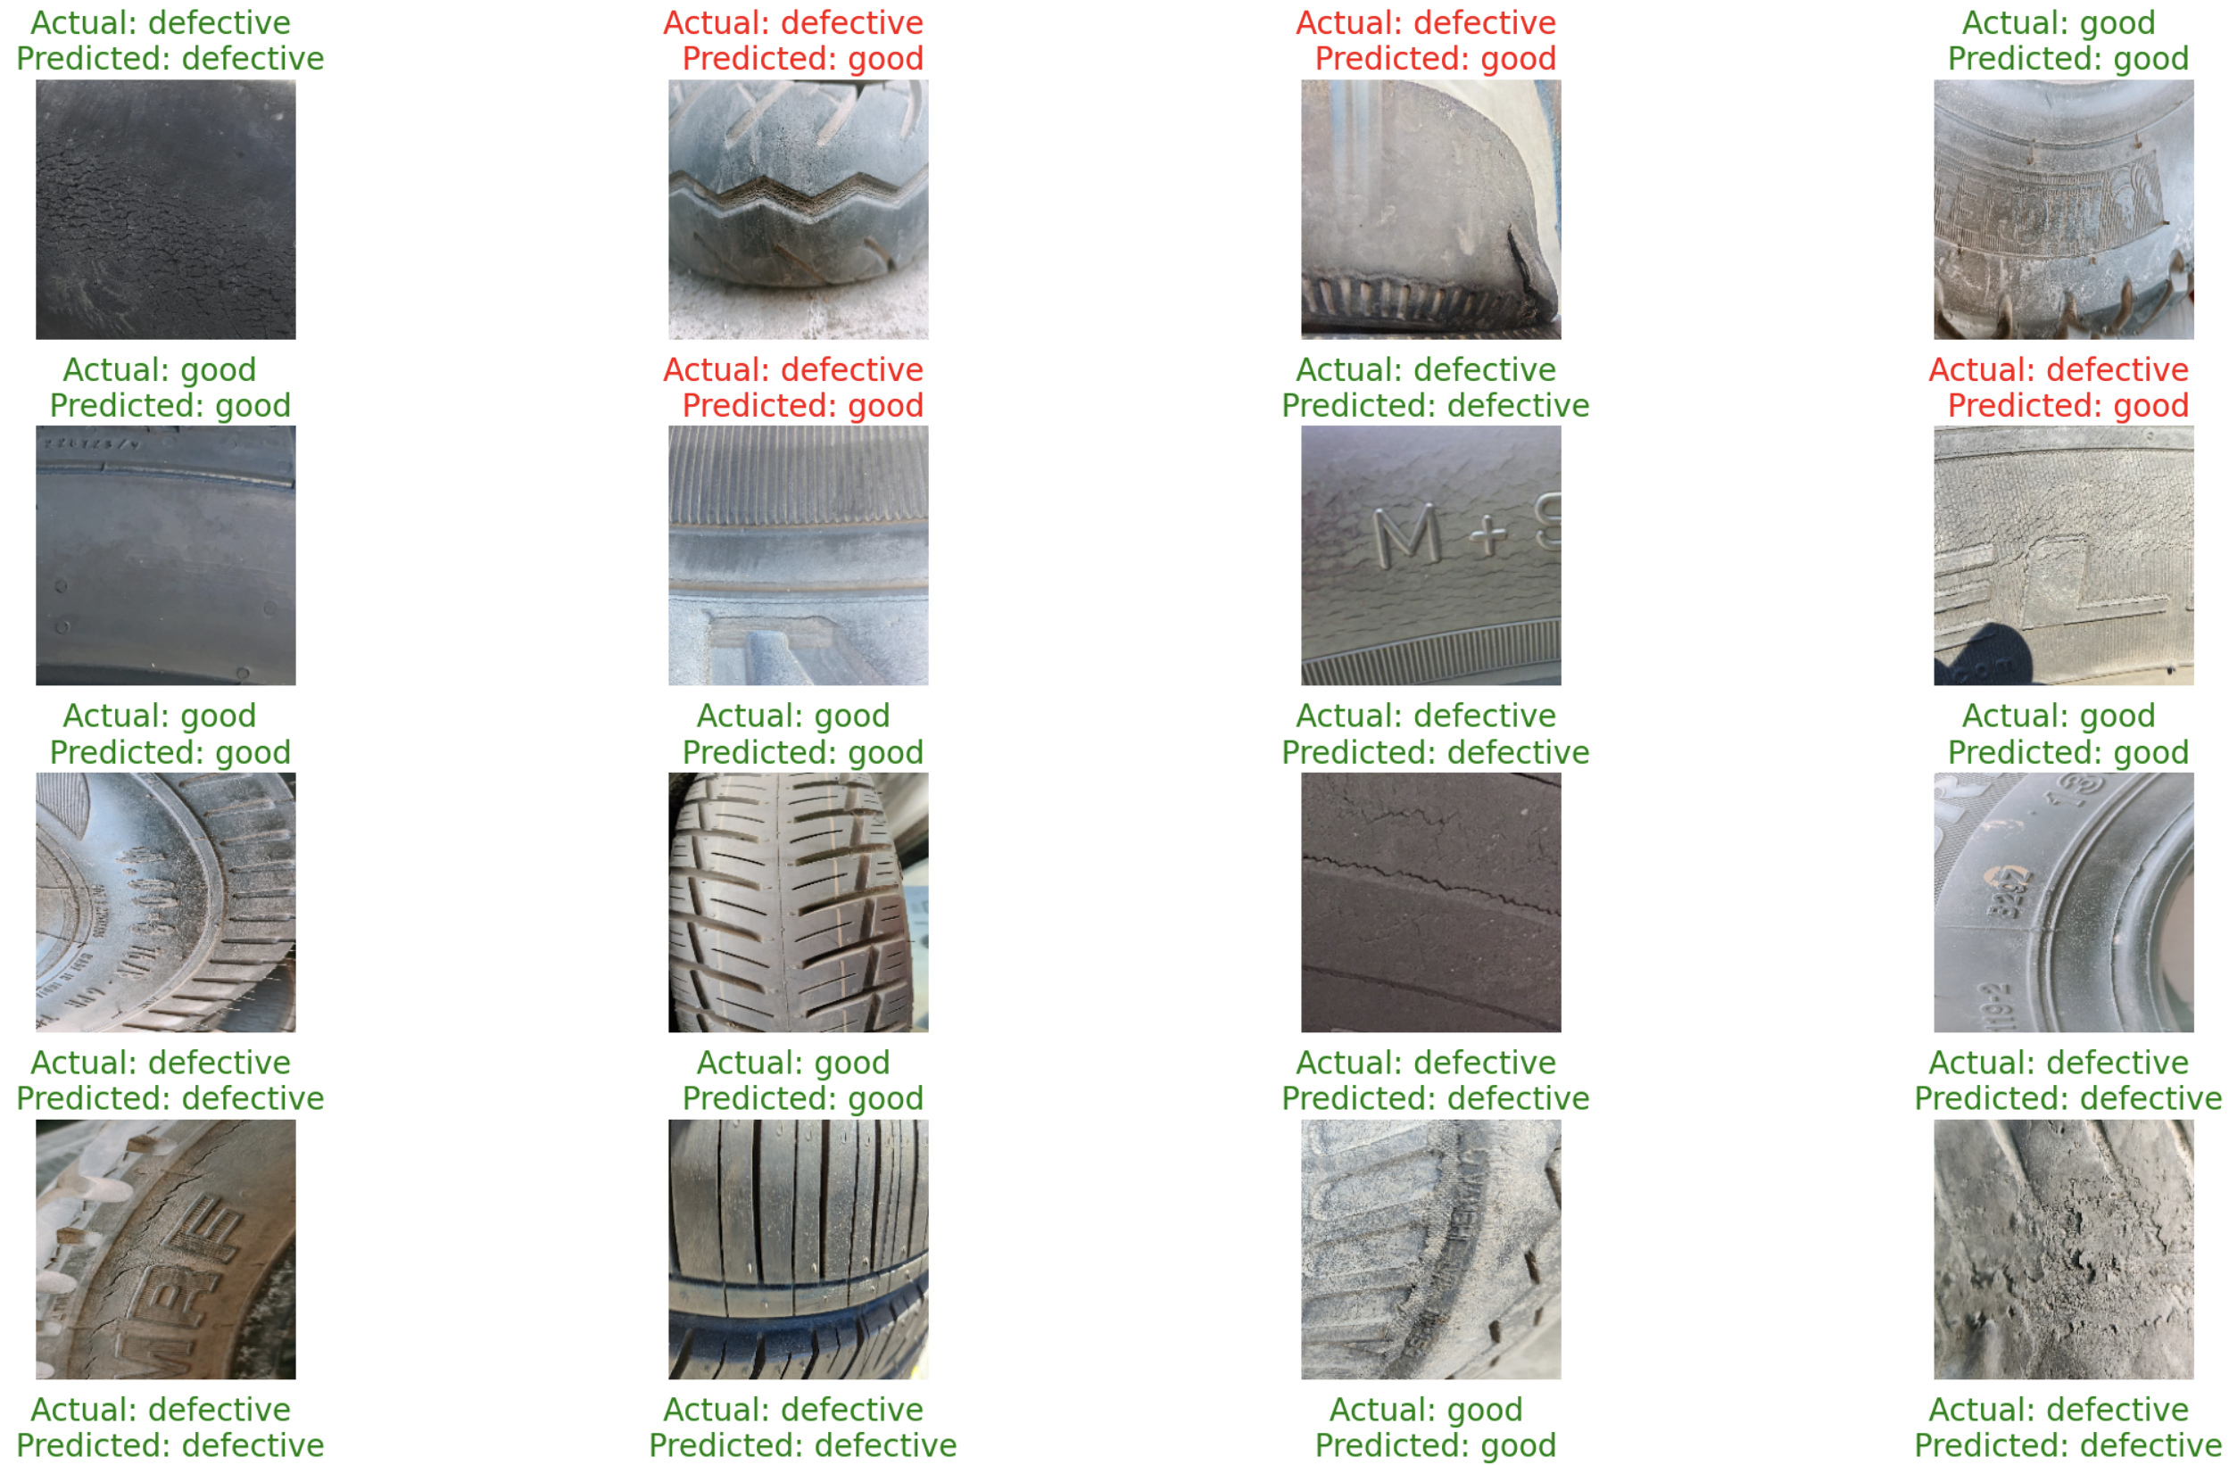
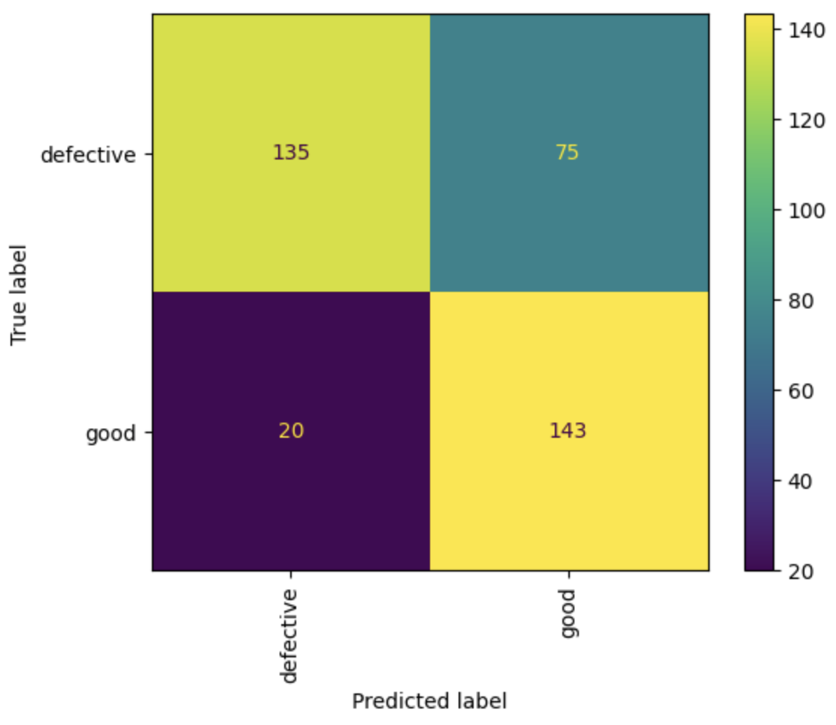
Preditions

